Slide 1
ASO321 Week #2
Summer 2020
Savik Ramkay
FBO & AIRPORT AUTHORITY PART II

Slide 2
Agenda
  Airports and Ground Equipment
  Assignment
  Ground Equipment
  Airside Safety

Slide 3
Assignment
  Posted online
  Due the week of June 14 ( week of) end of the day of your class
  Remember it must be submitted that week or else it will be graded as a zero (0) – I am on vacation as of July 1
Notes:
Let have a look at the assignment

Slide 4
1st way to find FBO Information
www.airnav.com
  Select the ‘Airports’ tab, enter airport code, scroll to bottom of page.
  You will find
    FBO name
    Contact info
    Website link
    Affiliates and reviews
    Fuel prices
    Car Rental, Limo and Hotel Information
    And a lot more....

Slide 5
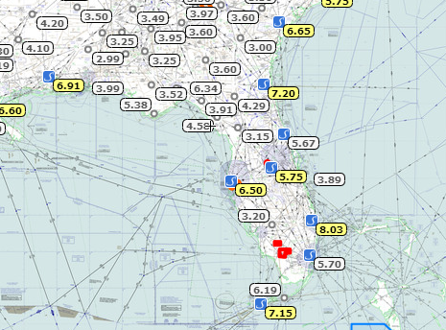
2nd way to find FBO Information
www.skyvector.com
  On the top right click on the ‘Layers’ button
  Select the FBO tab.
    Gas prices will be available at a glance across the country.

Slide 6
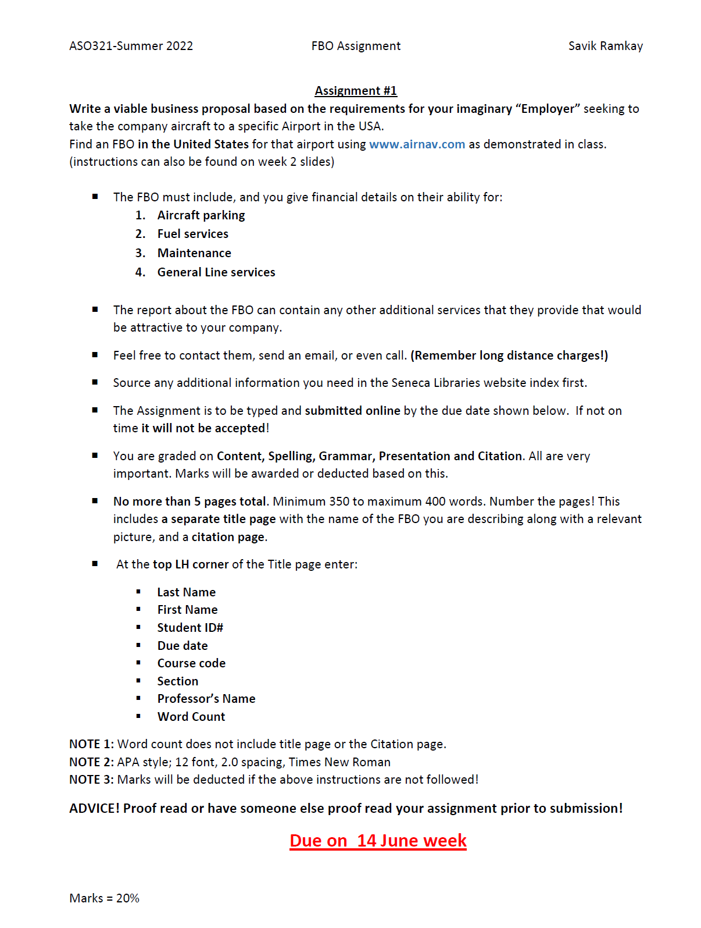
Assignment #1
(Available online now)

Slide 7
Homework
Start getting familiar with the Study Guide for the Restricted Operator Certificate with Aeronautical Qualification (ROC-A).
https://www.ic.gc.ca/eic/site/smt-gst.nsf/vwapj/ric21-upd-oct-2011.pdf/$FILE/ric21-upd-oct-2011.pdf
Also start getting familiar with marshalling signals as found in the AIM-AIR. (Self Study)
TC AIM – 1.8 Marshalling Signals p392 to 396
Posted on Black Board
Notes:
Please have a look at these 2 docs – study them we will need it to move on

Slide 8
Topics for today
Typical Equipment
Ramp Arrival
Wing Walking
Hangar Operations
Airside Vehicle Operations
Airside Markings/Lights
GPU Operation/Safety
Airfield Security
Notes:
Show ATI Training Video #1 General

Slide 9
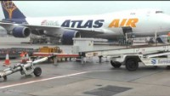
RAMP LIFE TRAINING
Notes:
Show ATI Training Video #1 General

Slide 10
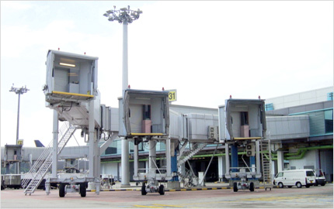
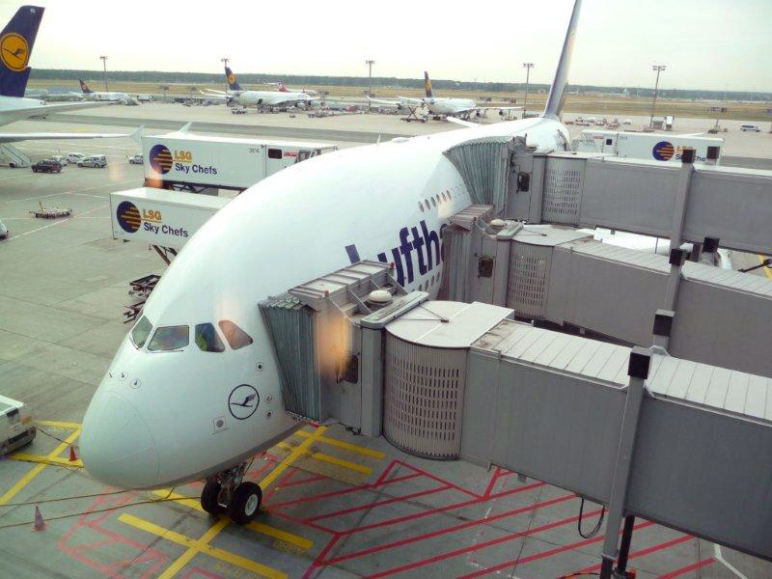
Loading Bridge (Jet Bridge)
Used for passengers to walk from the terminal directly on to, or from an aircraft.
Capable of manoeuvring on to most aircraft doors.
Notes:
http://airwaysnews.com/galleries/16943.jpg
http://www.shinmaywa.co.jp/english/products/images/img_07.jpg

Slide 11
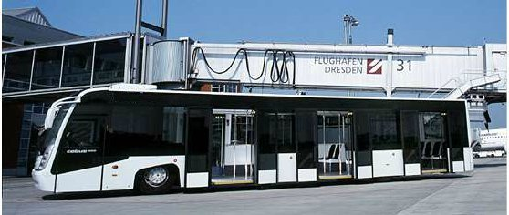
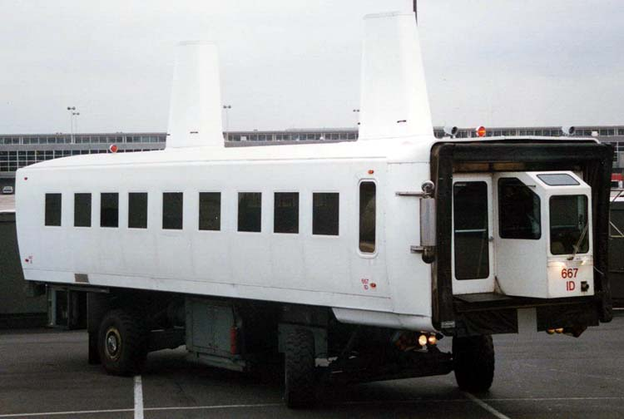
Apron Passenger Transport
The bus is used to transport passengers where a loading bridge is not available and the aircraft is far away. Why is it so short/low?
The larger vehicle is called a mobile lounge. Used for passenger transport and can directly fit up against an aircraft.
Notes:
http://www2.picturepush.com/photo/a/9323100/640/9323100.jpg

Slide 12
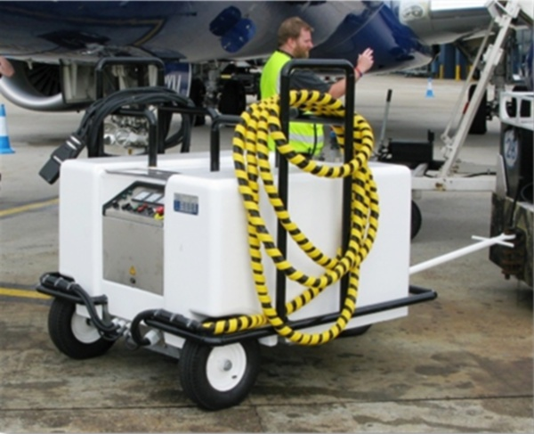
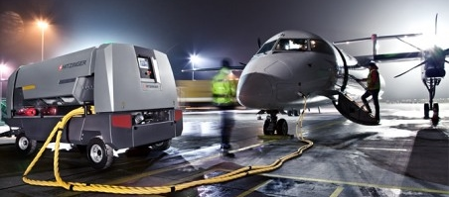
Ground Power Supply (GPU)
An independent power source for aircraft if their APU is not operational, or it has none.
Usually able to provide both AC and DC electricity
Notes:
http://djkeurope.com/files/hitzinger_dpower_1_0.jpg

Slide 13
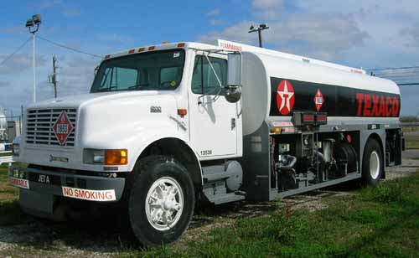
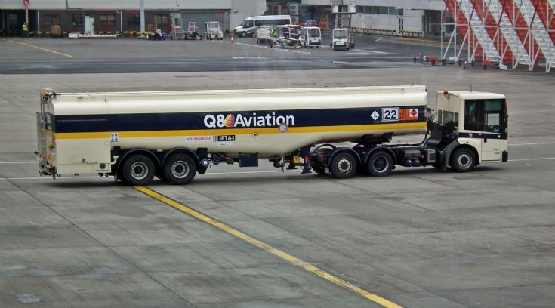
Fuel Trucks
Used to carry and pump fuel into an aircraft.
There are very strict safety procedures that must be followed in order to minimise the risk of fire.
What conditions do you think pose a high risk of fire?
Answer: Cold and Dry conditions!
Notes:
http://www.omegaaviation.com/fuel_trucks_aircraft_ground_support_equipment/fuel_truck_aircraft_determan_browning_5000_gallon_3.jpg
http://truck-photos.net.s3.amazonaws.com/8950.jpg

Slide 14
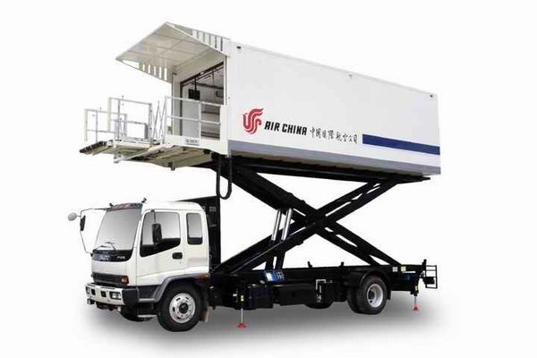
Catering Truck
Used to re-supply the galleys with all of the food, drinks, utensils, napkins, trays and other amenities.
Most are capable of positioning right up against the service door on aircraft near the galleys, no matter the height.
Notes:
http://www.guangtai.com.cn/English/admin/uploadfile/JPG/2007-8/3-57051-162.1.jpg

Slide 15
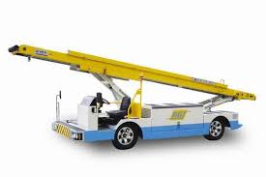
Cargo Loader/Belt
Used to load and unload Cargo and Baggage.
Usually, but not always, used on larger aircraft.
Most FBOs have at least one available.

Slide 16
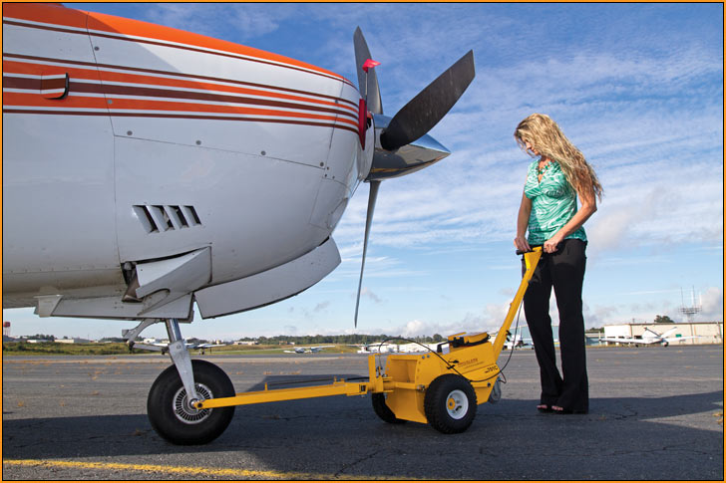
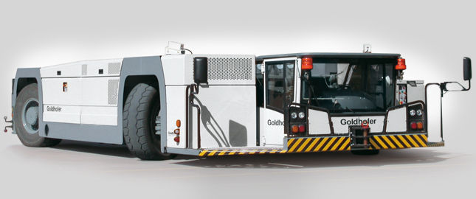
Tugs
Used to push or pull an aircraft in to a desired position or location. What is wrong here?
Small airplanes are usually moved with just a tow bar and human muscle.

Slide 17
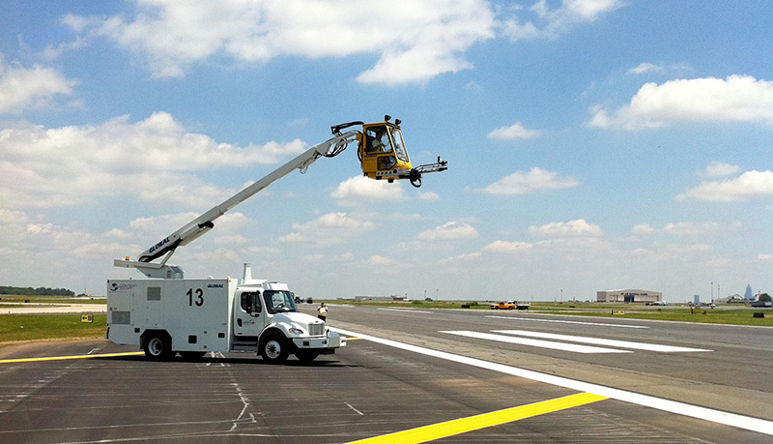
De-icing Equipment
Used to spray de-icing fluid on to an aircraft
This is a very dangerous operation and requires sharp communication and vigilant eyes. Why?
Notes:
http://www.tropolis.aero/wp-content/uploads/slideshow-gallery/IMG_0490.jpg

Slide 18
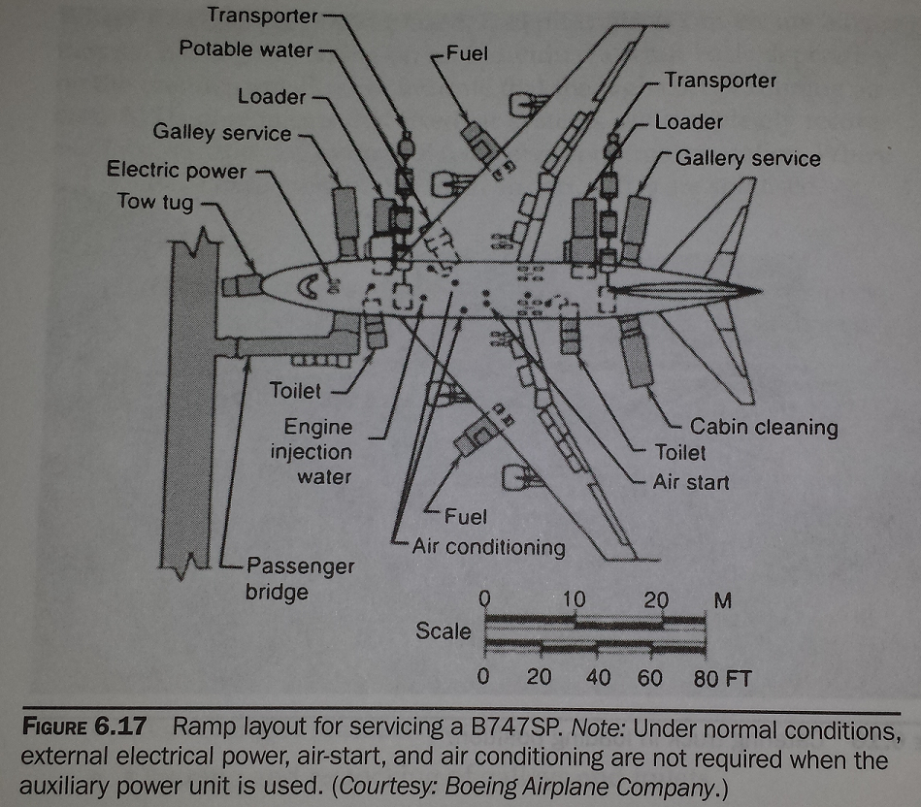
Boeing 747 servicing.
Notes:
Airport Operations , Third Edition, written by Norman J.Ashford, et al. (p168)

Slide 19
Aircraft Greeting (FBOs)
Ensure all incoming aircraft have:
Chocks – Give the pilot a signal when the aircraft is chocked so they can release parking brakes.
Carpet – FBO logo should face pilots/passengers as they disembark.
(Once everyone has exited aircraft, incase of a quick turn - turn carpet so the FBO logo faces pilots/passengers as they embark.)
Chocks/Carpet should be ready before engine shutdown so they are in place after engines shutdown and before door opens.

Slide 20
Wing Walking
A wing walker’s job is to:
  Provide an extra set of eyes for a tow operator.
  Alert the tow operator to any potential conflicts.
Before a tow begins
  the tow operator should make clear, (and the wing walker should ask) what will be moved, and where to?
  Everyone should identify the potential *Crunch* points.
A wingwalker should always have:
  Whistle Ready
  Chocks Ready
  Eyes Open

Slide 21
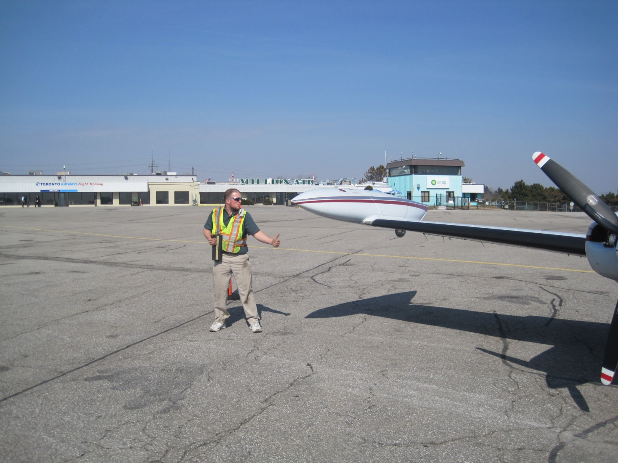
Proper Wing Walking
Anything wrong here?
When an aircraft reaches its final position, the wingwalker should always blow the whistle. (Whistle = STOP)
IF IN DOUBT, STOP, CHECK, then proceed.

Slide 22
Wing Walking Tips
IF IN DOUBT, Always Stop & Check.
Give a thumbs up so the operator knows when they look at you that everything is OK.
Verbal signals are preferred.
Verbal signals must be LOUD!
The airport can be a loud place. Ensure you get the operator’s attention!

Slide 23

Take a Break!
Notes:
Hand out copy of Directives for Operations of Vehicles

Slide 24
Hangar Operations
General safety rules also apply to aircraft movements in the hangar, with the following additional procedures and precautions.
Remember that you are moving a 3 dimensional object. Therefore you must be aware at all times of the position of the wings, tail – both vertical and horizontal surfaces – front and rear of the aircraft.
Obstructions can include hangar door openings, and as well as equipment, vehicles and other aircraft positioned in the area.

Slide 25
Hangar Operations cont’d
Before moving an aircraft in or out of a hangar perform a walk-around check to make sure the towing area is clear of other equipment, the passenger door is stowed, or raised up, prior to towing.
Also check the aircraft for existing damage.
If you detect any damage report it to your supervisor before moving the aircraft!
Do not move the aircraft until the issue or concern related to the damage is resolved!

Slide 26
Hangar Operations cont’d.
A wing walker is essential and required for all hangar towing movements. If the person towing the aircraft loses contact with the wing walker, or they do not understand the directions being given by the wing walker they must STOP immediately!
The wing walker must always maintain eye contact with the tug/lektro driver. Use the same hand signals that are used to marshal an aircraft, vocalize the situation if necessary.
The wing walker should not hesitate to call out STOP! and/or use their safety whistle if they see a problem or are unsure of clearances.

Slide 27
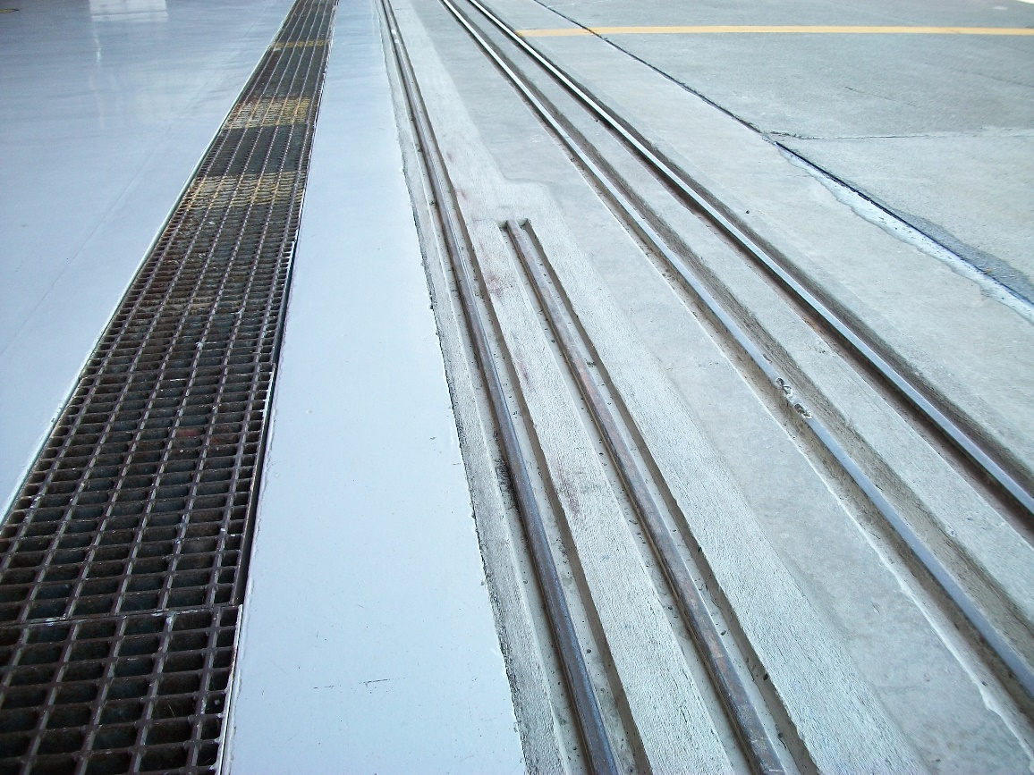
Hangar Operations cont’d.
When moving aircraft over hangar door tracks avoid stopping the aircraft with one of the main wheels in the tracks.
To avoid this maintain a slow and constant speed as you push or pull the aircraft over the tracks.

Slide 28
Hangar Operations cont’d.
Approach hangar tracks straight on so that each main wheel goes over the tracks at the same time. This principal also applies when moving an aircraft over icy ruts or heavy snow.
Check movement area for parts, toolboxes, ladders, platforms.
If aircraft already in the hangar have to be moved to accommodate others, make sure that they are not undergoing maintenance – which may mean they are supported on jacks or have tail stands positioned.

Slide 29
Hangar Operations cont’d.
Do not move the aircraft, contact the maintenance engineer.
Never move an aircraft that has a red maintenance tag on the nose gear
Let’s discuss typical Hangar organization
Avoid overlapping wing surfaces
Avoid putting aircraft surfaces within the propeller arc of another.

Slide 30
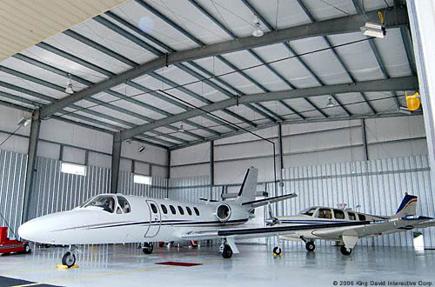

Slide 31
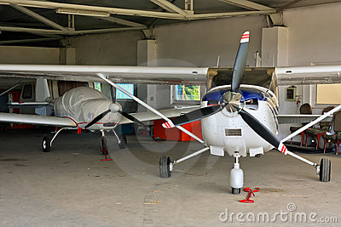

Slide 32
Airside Vehicle Operations (AVOP)
In YYZ, you may be required to pass a written test on the Directives for Operations of Vehicles and demonstrate practical knowledge before solo operation of vehicles airside.
Do you recall the definitions of Movement Area, Maneuvering Area, Apron, Controlled Airport?
The operator is responsible for ensuring a vehicle is safe before operation. Report hazardous conditions to your supervisor immediately.
Airside Vehicle Operating Privileges can be suspended or revoked for non-compliance with these directives.
Notes:
Hand out copy of Directives for Operations of Vehicles

Slide 33
AVOP continued
Enforcement Officers at the GTAA are personnel primarily responsible for enforcing the AVOP Program. These are Aviation Safety Officers (ASOs).
The following personnel are also authorized to enforce the AVOP Program:
  Peel Regional Police (PRP)
  Airport Division Officers and Designated GTAA management.
  GTAA AVOP Examiners. (As part of the enforcement and safety audit of the AVOP program, GTAA AVOP Examiners are authorized to undertake airside spot checks and tests of competency both randomly and for cause.)
Notes:
Hand out copy of Directives for Operations of Vehicles

Slide 34
AIRSIDE VEHICLE SPEED LIMITS
45 km/hr on Runways / Taxiways
30 km/hr on Aprons
15 km/hr in vicinity of moving aircraft, at intersections, around buildings
NOTE:
These are maximums.
What is the maximum speed around aircraft?
5 Km/hr!
Reduce speeds as traffic or weather conditions change and your vehicle condition dictates.

Slide 35
RIGHT OF WAY!
Aircraft Always Have Right Of Way!
Otherwise, Right-of-way is as follows:
Aircraft
Emergency Vehicles responding to an emergency
Maintenance vehicles conducting snow removal
Service vehicles (likely you!)
Notes:
Pilots generally have poor visibility of area around, especially to sides of and behind aircraft.

Slide 36
VEHICLE EQUIPMENT
Vehicles with a cab must have a flashing beacon, or 4-way flashers while on the movement area. These indicate to an aircraft that a vehicle is in operation.
  Yellow Beacon = Service Vehicles
  Blue Beacon = Snow Removal Vehicles
  Red Beacon = Emergency Vehicles
Headlights/Tail lights/Parking lights must be operated during hours of darkness.

Slide 37
PARKING VEHICLES (Rules)
Vehicles shall not be parked or left unattended blocking aircraft movement areas or vehicular routes.
Vehicles should be backed into parking areas, especially around buildings. (Tankers excepted.) Why?
Vehicles must be chocked during fueling operations.

Slide 38
VEHICLE ESCORT
Vehicles not operated by persons with Airside Operating Authority must be escorted by a person with said Authority.
Person with said Authority can be within the vehicle or in an escort vehicle.
The operator of the vehicle to be escorted should be instructed to:
  Activate 4-way Flashers
  Follow escort vehicle at all times while Airside

Slide 39
Maneuvering Area Operations
A functioning radio is required for Maneuvering Area operations.
An ATC ground controller is responsible for maneuvering area operations. Obey instructions!
Vehicles Holding Short of a runway must be 30 m / 100 ft from nearest edge or behind double-solid lines painted on taxiways.
Runway lights flashing on and off is a signal to all vehicles to exit runway immediately!
In case of equipment breakdown, notify ground controller (ATC) immediately of location and request assistance.

Slide 40
Maneuvering Area Ops - cont’d
In case of radio failure while in maneuvering area:
  Turn vehicle to face Control Tower and flash headlights on/off
  Watch for light signals from the tower as follows:
    Flashing Green – Proceed
    Steady Red – Stop
    Flashing Red – Vacate Runway
    Flashing White – Return to Start Point on Airport
As you proceed back to start point, hold short of any runway you must cross and wait for permission to proceed

Slide 41
AIRSIDE MARKINGS, SIGNS & LIGHTING
Always stop on the solid side of the Hold Line.
Aerodrome Beacon: Rotating white light mounted atop
Edge Lighting of Movement Area Surfaces:
  Blue – Taxiway Edges
  White – Runway Edges
  Amber – Apron / Taxiway Intersections
  Red/Green – Runway Thresholds
Signs:
  White Text on Red – Runway Identification
  Yellow Text on Black – Current Taxiway
  Black Text on Yellow – Direction to Taxiway
15-33
A
B1 →

Slide 42
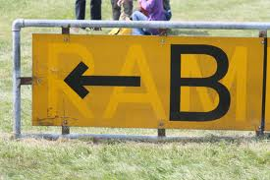

Slide 43
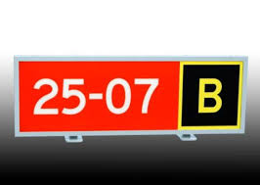
So what does this mean?
Notes:
Runway and your current taxiway

Slide 44
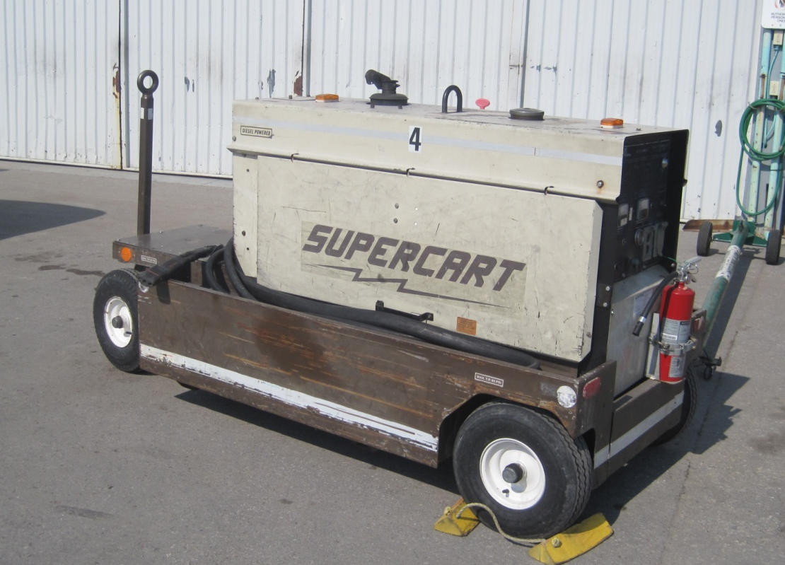
Ground Power Units (GPUs)
Ground Power Units provide electrical power to aircraft on the ground
They can provide
  12 volts DC
  28 volts DC
  110/115 volts AC
Electrical power is provided by batteries or a generator driven by a diesel or turbine engine.

Slide 45
Ground Power Units cont’d.
GPUs can be started and run at low idle until it is needed (especially in winter).
Never connect or disconnect a GPU until the pilot or maintenance gives the ok.
NOTE:
ALWAYS ENSURE THE CABLE IS DE-
ENERGIZED WHEN CONNECTING /
DISCONNECTING THE CABLE.
(Explain AC Power Cable Safety features here)
Notes:
Always check the diesel level before towing a GPU. Note those which need refueling.

Slide 46
GPU Connection Procedures
Take the GPU out of the hangar
Check the fluid levels
Hold the breaker switch in
Engage ignition of the motor
Place the GPU in position near the aircraft port, behind the aircraft and out of the slipstream of the propeller or jet blast
Plug the GPU power cable into the aircraft ground power port

Slide 47
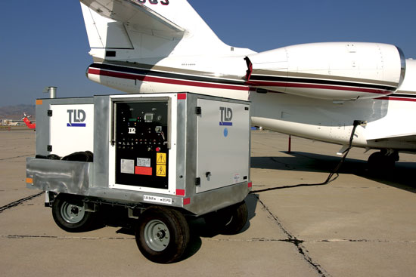
GPU Connection Procedures cont’d.
Wait for the pilot or maintenance to give the GPU connect signal
Activate the GPU power to the aircraft
Ensure proper voltage is delivered to the Aircraft
Confirm with the pilot/maintenance that the GPU is powering the aircraft

Slide 48
GPU Disconnection Procedures
Wait for pilot or marshaller to give the GPU disconnect signal
Switch power to the aircraft ‘OFF’
Disconnect the cable from the aircraft GPU port and wrap it around the GPU (Why?)
Inform the pilot/marshaller (via marshalling signal) that the GPU has been disconnected
Tow the GPU away slowly
Let the GPU run for 5 minutes to recharge batteries (if applicable)
Shut the GPU down
Recheck fluids and top up if necessary

Slide 49
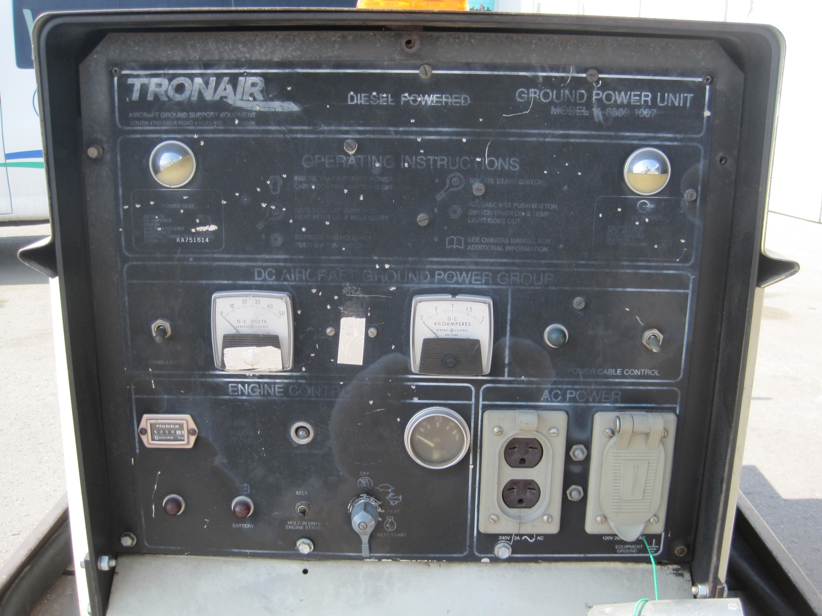
GPU Control Panel (typical)

Slide 50
Airfield Security
Walls, locked doors, fences, and locked gates form a security perimeter around the airport’s movement area. Report any breaches (Doors/Gates that don’t lock) immediately.
Some personnel are issued passes which act as door keycards and identification.
Any persons in the restricted (movement) area who you do not recognize and are acting suspicious should be confronted. If they cannot produce a pass or pilot license, they should be reported to your supervisor and escorted out of the restricted area.

Slide 51
GATE OPERATIONS
Some vehicles have remote gate openers.
Some gates can also be opened by a combo keypad. Many times there is a guard.
Whoever opens a gate is responsible for ensuring it closes behind them. Do not drive away until the gate is fully closed.
IMMEDIATELY Report any gate that does not close. This is a security risk.
Who is Secret Sam?

Slide 52
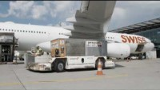
Airport & Ramp Safety

Slide 53

You still here?

